Slide 1
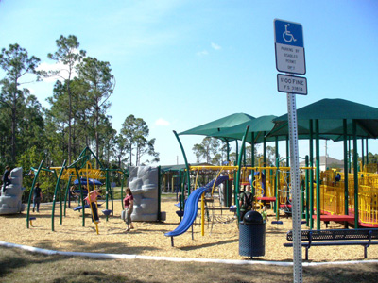
Palm Bay Plays

Slide 2

Final Meeting
Met with client
Discussed success of event
Gave feedback on event
Signed paperwork

Slide 3

Plans
Meet Thursday
Finish Reflections Report
Work on final
presentation
Update website

Slide 4
Geocaching
Geocaching is a high-tech treasure hunting game played throughout the world by adventure seekers equipped with GPS devices. The basic idea is to locate hidden containers, called geocaches, outdoors and then share your experiences online. Geocaching is enjoyed by people from all age groups, with a strong sense of community and support for the environment.

Slide 5
Geocaching
A geocacher can place a geocache anywhere in the world, pinpoint its location using GPS technology and then share the geocache's existence and location online. Anyone with a GPS device can then try to locate the geocache.
www.geocaching.com

